Slide 1


NBA Future Analytics Stars Exercise
2025-26 ROTY Prediction
By: Grant Boydell
UCLA, Class of 2027
Economics, Statistics/Data Science
Notes:
Quick introduction on yourself: 20 secs

Slide 2
Data Acquisition and Cleaning
All player data was obtaining from the hoopR package, looping through seasons using the nba_leaguedashplayerstats() function with player_experience = “Rookie” to extract basic and advanced rookie statistics
Joined these two dataframes to access over 100 variables for modeling and added a column to indicate if that player won the rookie of the year award (1 = win, 0 = did not win).
Recognized the importance of feature engineering variables like season ranks for each statistic to standardize across seasons. This allowed for adjustment to abnormal years and/or overall changes in the game.
Conducted exploratory analysis and found which variables past ROTY winners ranked highly in, to get a list of beginning variables for modeling.
Variable | Average Rank
Points | 1.6
Assists | 4.9
Rebounds | 7.2
FGM | 1.6
FTA | 1.9
Fantasy Points | 1.4
Average ROTY Winner Ranks: Grouped by Year
Note: All data is up to November 29th
Notes:
Things to highlight: 1) feature selection of rank variables -> has the effect of stratifying/standardizing analysis across years (thus accounting for changes in play style/basketball over time, etc.)
2) Exploratory analysis fueled your own feature selection process

Slide 3
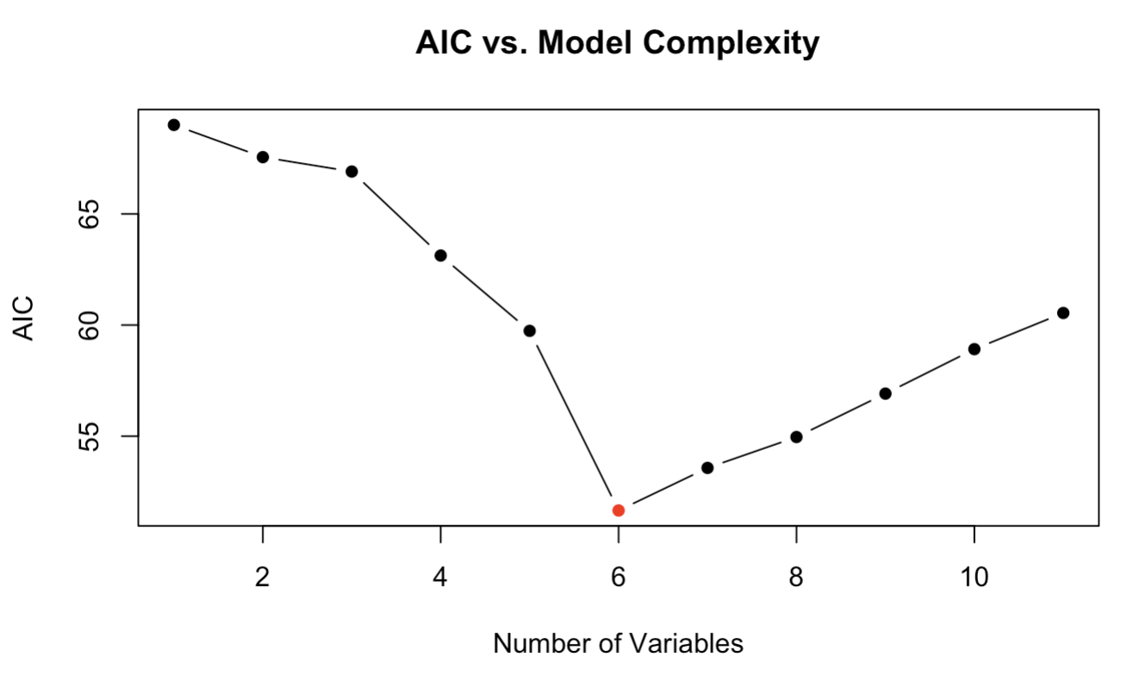
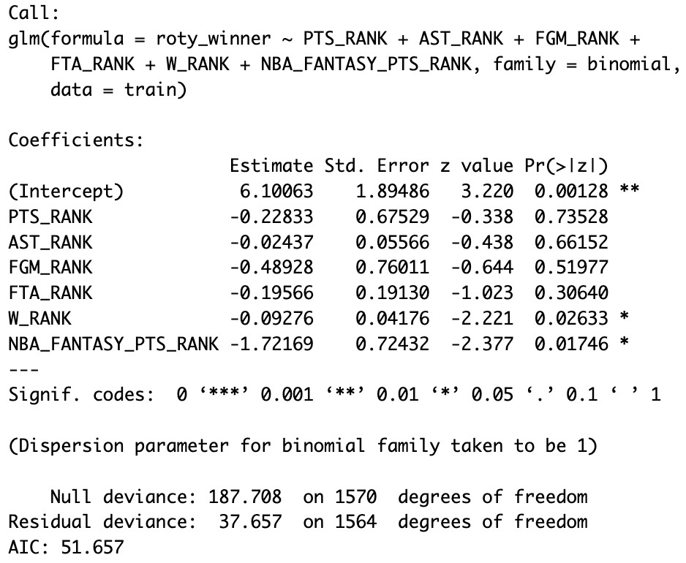

Modeling Methodology
Logistic regression was used to output probabilities for winning ROTY because of binary classification (win or not) and variable interpretation.
Performed manual forward stepwise selection, using a set of features deemed relevant via the explanatory analysis.
Added variables, looking to minimize residual deviance (how well fitted the model based on residuals) and AIC (a metric that penalizes more variables but rewards if the model if prediction are closer to actual values).
This goal of building a well-fitted model was aided by these metrics that demonstrated how close the model’s probabilities were to the actual winners, settling on the model output to the right (the red dot is the model used on the AIC graph).
Model Pseudo-$R^{2}$: 0.7993307
Notes:
Things to highlight: 1) Decision criteria of residuals deviance and AIC (penalizing model complexity)

Slide 4

Testing and Prediction
Model was trained on all the NBA seasons between 2002-22 and was tested on the three seasons below.
Prediction uses current season ranks up as of November 29th and assumes ranks hold throughout the season.
2022-23 (Test)
2023-24 (Test)
2024-25 (Test)
2025-26 (Prediction)
Player | Probability of Winning ROTY
Paolo Banchero | 0.625
Jaden Ivey | 0.009
Jalen Williams | 0.004
Player | Probability of Winning ROTY
Victor Wembany-ama | 0.805
Chet Holmgren | 0.450
Brandon Miller | 0.011
Player | Probability of Winning ROTY
Stephon Castle | 0.380
Alex Sarr | 0.014
Yves Missi | <0.001
Player | Probability of Winning ROTY
Cooper Flagg | 0.842
VJ Edgecombe | 0.080
Kon Knueppel | 0.050
Notes:
Things to highlight: 1) train and test split --> why you chose to test with most recent years (mimics applying model for prediction in current/future years)
2) "accuracy" for last 3 years when you set the threshold for classification to just be the highest probability entry

